Slide 1

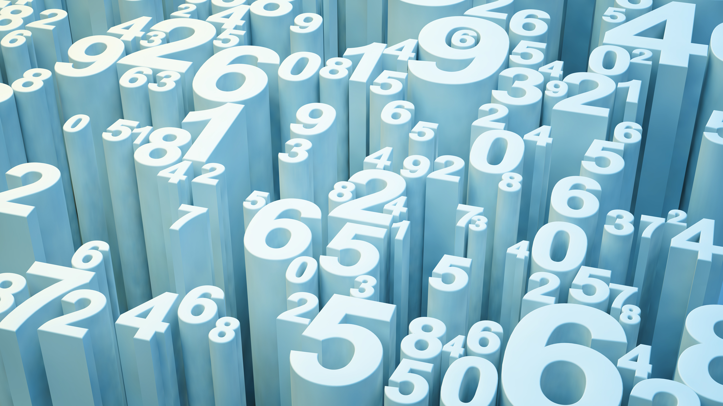
Introduction to Data Science
Kiran Komati

Slide 2
Summary
What is Data Science?
Why Data Science?
How Data Science?
Real world Examples
Conclusion

Slide 3
What is Data Science?
Combination of Statistics and programming skills.
Process to get valuable insights from different types of structured and unstructured data.
Used to make decisions and predictions.

Slide 4
Why Data Science?
More and more data everyday.
Harder to process data and find accurate information with traditional methods.
Allows Management to Make Better Decisions.
Identify key opportunities.
Build innovative methods.

Slide 5
How much Data is generated every day?
In 2018, more than 2.5 quintillion bytes of data were created every day.
As of July 2020, there were over 4.8 billion internet users in the world.
Google handles a staggering 1.2 trillion searches every year.
In 2019, 188 million emails were sent in the world every minute.
By 2030, 90% of the population older than six will be online.

Slide 6
How Data Science?
Extract, preprocess and Analyze large sets of data.
Each company has their own needs of Data.
Can predict issues and streamline processes.
Analyze customer behavior and identify patterns.
Discover and Refine target customers and audiences of a product.

Slide 7
Real world examples
Google
maps predicts time, shortest route for a destination.
Analyze vehicle traffic data and predict traffic patterns.
Predicts best time to visit a place.
Youtube suggestions.
Autofill searches.

Slide 8
Real world examples
Fighting variety of diseases and illnesses
Helped in eradicating Polio in Africa.
Helped in predicting outbreak spreads of Covid-19.
Helped in variety of Vaccine researches.

Slide 9
Real world examples
Better weather predictions
Identify extreme weather conditions before hand and alert people.
Prediction of natural disasters such as floods and cyclones.
Helps governments to act swiftly and reduce damage and causalities.

Slide 10
Real world examples
And many more……

Slide 11
Conclusion
Data is the new currency.
Every industry has big sets of unstructured data.
Gathering right data is as crucial as collecting big data.
Data science can have major impact on industries.

Slide 12
References
Vuleta,B.(2020 January 30) How Much Data Is Created Every Day?
https://seedscientific.com/how-much-data-is-created-every-day/

